Slide 1
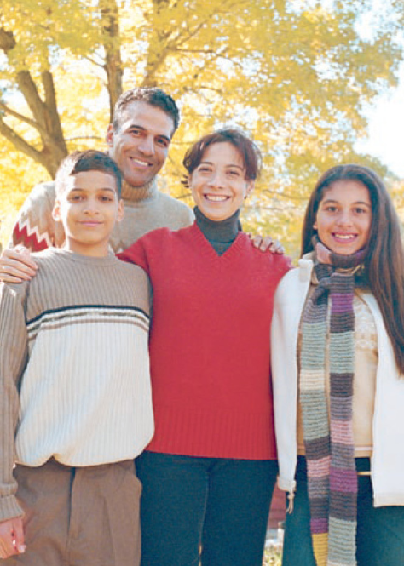
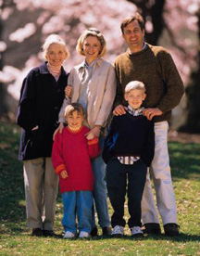
Genetics: The scientific study of heredity.
Heredity: The passing of physical characteristics from parents to offspring.
Traits: the different forms of a characteristic
Ex.) eye color: blue, brown, green
Ex.) height: short, medium, tall

Slide 2
Traits can be passed from generation to generation through 2 primary methods ….
Asexual reproduction
Sexual reproduction

Slide 3
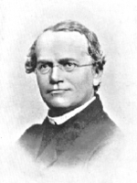
Gregor Mendel
Austrian priest/monk
born July 22, 1822; died January 6, 1884
Known as “The Father of Genetics”
In his job as the monastery gardener, Mendel worked extensively with pea plants to determine how traits are passed from generation to generation.
Now read pages C104-C105

Slide 4
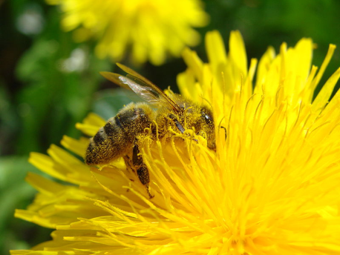
Mendel’s experiments
Mendel fertilized pea plants by cross-pollinating the flowers of purebred pea plants.
Fertilization: the process by which the egg & sperm cell of an organism combine to form a new organism.
Pollination: the transfer of pollen from the pistil of a flower to the stamen of another flower.
Purebred: the offspring of many generations with the same traits.
Ex.) Short parents always produce short offspring.
Ex.) Blue-eyed parents always produced blue-eyed offspring.

Slide 5
Mendel’s breeding experiments
Ex.) Seed color
Parents (P)
First generation (F₁)
Female sex cells
from a purebred yellow-seeded plant
Male sex cells in pollen from a purebred green-seeded plant
Cross fertilized (crossed)
All seeds produced turned out yellow
© 2007 Paul Billiet ODWS

Slide 6
Mendel’s breeding experiments
Ex. Continued.) Seed color
1st generation(F₁)
2nd generation (F₂)
Female sex cells
from a yellow-seeded plant
Male sex cells in pollen from a yellow-seeded plant
Cross fertilized (crossed)
3/4 yellow
¼ green
© 2007 Paul Billiet ODWS

Slide 7
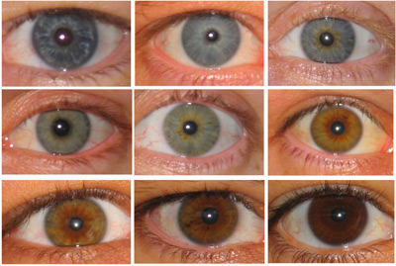
Mendel concluded
Mendel believed that individual factors or sets of genetic “information” must control the inheritance of traits.
The factors that control traits exists in pairs.
Each parent (mother & father) contributes 1 of the factors.
One factor in the pair can mask or hide the other factor.
Gene: the factors that control a particular trait.
Ex.) eye color, height, hair color, nose shape, etc.
Allele: the different forms of a gene
Ex.) eye color: brown, blue, green
Now read pages C106-C107

Slide 8
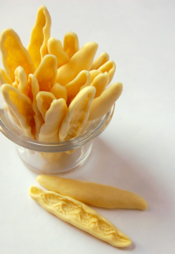
Dominant allele
The stronger form of the gene that will always show up.
Uses a capital letter
Ex.) Seed shape: round (R)
Ex.) Seed color: yellow (Y)
Recessive allele
The weaker form of the gene that will only show up if there are 2 recessive alleles.
Uses a lower case letter of the dominant allele for a trait.
Ex.) Seed shape: wrinkled (r)
Ex.) Seed color: green (y)

Slide 9
Dominance versus Prevalence
Just because a particular trait is dominant, does not mean it is more prevalent.
Prevalent: majority; happens, takes place or is found most often.
Ex.) Seed color: Yellow is dominant; Green is prevalent
Ex.) Widow’s peak: Having one is dominant; Not having one is prevalent
This is good because there are some genetic diseases that are found on a dominant gene but they are less prevalent in society.

Slide 10
With your table partner, answer the following questions on page C107.
#2
#6
What is the difference between dominant alleles and recessive alleles?

