Slide 1
Notes on Fronts

Slide 2
Air Masses
An air mass is a giant “bubble” of air with similar temperature, pressure, and moisture throughout it.
Air masses moving around cause weather.

Slide 3
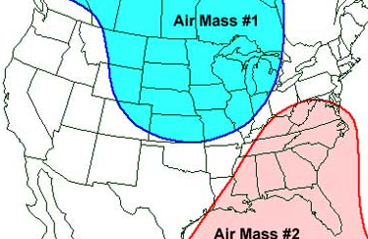

Slide 4
Types
Polar: Cold air mass from over one of the poles. High pressure. Not humid.
Tropical: Warmer air from the middle regions of the globe. Low pressure. humid.
Continental: Air mass that forms over LAND
Maritime: Air mass that forms over WATER
You can combine these terms to be specific:
“Maritime Tropical”:
-Warm, low pressure, over water near equator
“Continental Polar”:
-Cold, high pressure, over land near poles.

Slide 5
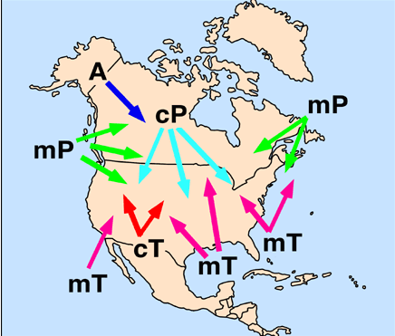

Slide 6
Fronts
Front- a boundary where two air masses are touching.

Slide 7
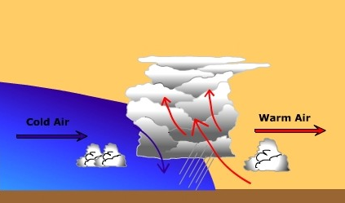
Cold Front
Cold Front: Cold air is pushing warm air out of the way, it moves quick and can produce thunderstorms.

Slide 8
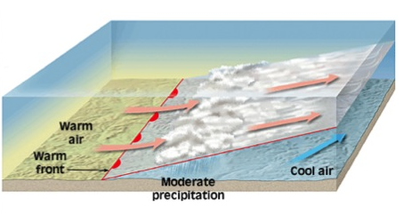
Warm Front
Warm Front: Warm air mass pushes cold air mass out of the way, moves slowly, can produce days of rain and clouds.

Slide 9
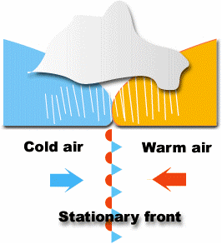
The Weird Ones
Stationary Front: Two air masses cannot move each other and are “stalled” over an area. Can cause days of rain or snow.

Slide 10
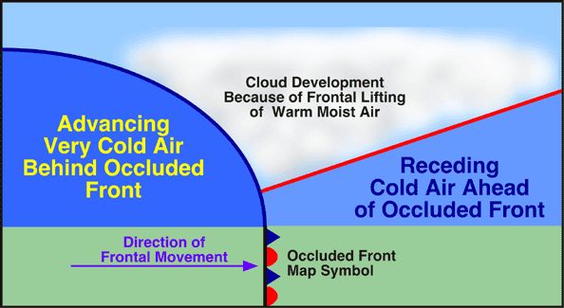
Occluded Front: Warm air gets trapped above two colder air masses.

