Slide 1
Warm-Up
On Page 3 in your notebooks complete the following questions.
What are the 7 steps to the Scientific Method?
What was your favorite thing about Science class last year?

Slide 2
Scientific Method and Variables
7th grade science

Slide 3
Scientific Method
Develop a question that can be answered by experimenting.
Observe and research the topic.
Create a hypothesis (“I think…because…”).
Develop a procedure.
Experiment. Modify your experiment if needed.
Collect and analyze results.
Make conclusions.

Slide 4
Variable
A factor that is measured in an experiment
Independent variable—the factor adjusted by the experimenter
Dependent variable—what you are going to measure in the experiment—it DEPENDS on the independent variable

Slide 5
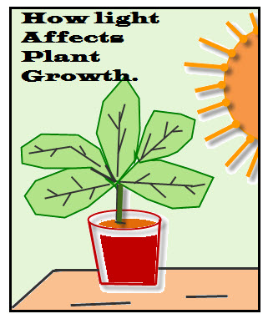
Examples
Which is the independent variable?
Which is the dependent variable?

Slide 6
Examples
Which is the independent variable? the amount of light
Which is the dependent variable?
the plant’s growth

Slide 7
Constant
A factor that does NOT vary in an experiment
What should stay the same during this experiment?

Slide 8
Constant
A factor that does NOT vary in an experiment
What should stay the same during this experiment?
*type of plant
*container
*amount of water
*type of soil

Slide 9
Control
The standard that you compare everything to in the experiment
It’s the original thing that you are going to compare your changed item to during your experiment

