Slide 1
Important Cell Vocabulary
7th grade science

Slide 2
Organism
Anything that can be alive

Slide 3
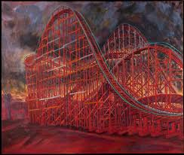
Structure
The way that something is built or organized
How is this roller coaster structured?

Slide 4
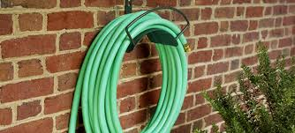
Function
The purpose for which something exists
What is the purpose of this object?

Slide 5
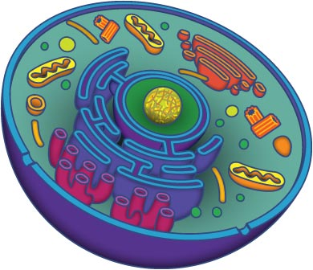
organelles
Little “organs” inside cells

Slide 6
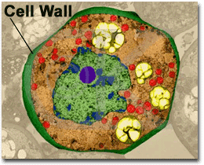
Cell wall
The outer layer of plant cells; gives shape to the cell and protects it

Slide 7
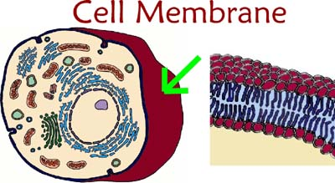
Cell membrane
Think layer that forms the outside of an animal cell; lets the right things in and keeps the wrong things out

Slide 8
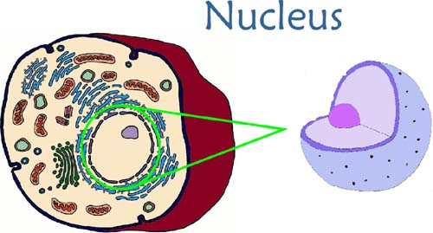
Nucleus
Control center of the cell; it contains DNA

Slide 9
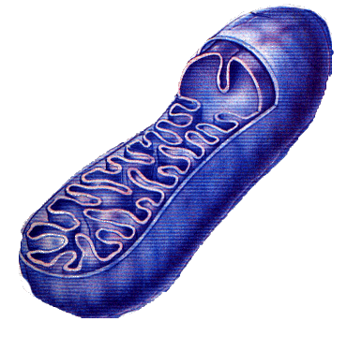
Mitochondria
Break down food and convert it to energy

Slide 10
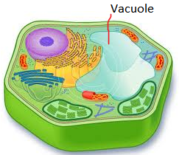
Vacuole
Storage space within a cell

Slide 11
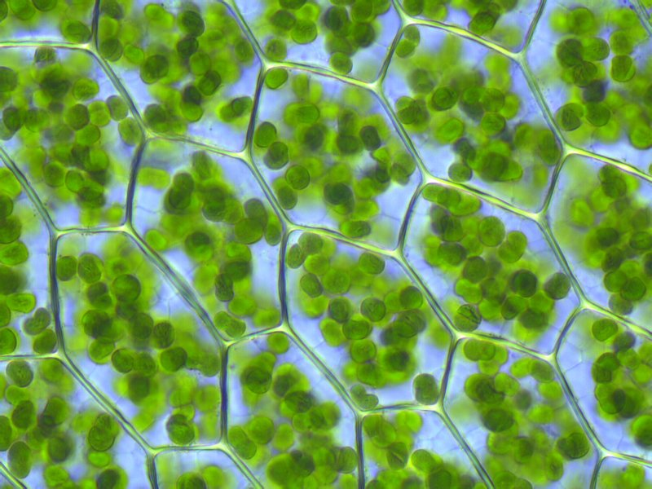
Chloroplasts
Plant cell structure that has chlorophyll, which helps in photosynthesis
The green parts are chloroplasts.

